Slide 1


Food Delivery System
DSA SEMESTER PROJECT
Presented by
- Fahad Imran 4782 FOC BSSE F23 B - Safeerullah Khan 4815 FOC BSSE F23 B
- Hamza Zeeshan 4809 FOC BSSE F23 B
- Reshail 4785 FOC BSSE F23 B

Slide 2


Project Overview
Developed in C++ for Data Structures & Algorithms course.
Simulates a real-life food delivery platform.
Focus on efficient data structure design and algorithms.
Includes menu browsing, ordering, payment, and delivery tracking.

Slide 3

System Architecture
User Module: Input handling and order placement.
Restaurant Module: Manages menu and order processing.
Order Module: Uses custom queue and BST structures.
Delivery Module: Priority-based delivery assignments.

Slide 4

Data Structures Used
Linked List – Dynamic user management.
Queue (OrderQueue) – FIFO processing with priority.
BST – Menu sorted by price.
Hash Map – Fast access to menu items by ID.
List – Delivery driver management.

Slide 5
Algorithms Implemented
Quick Sort – For sorting orders by total price.
Merge Sort – Used as an alternative to sort orders.
Binary Search – Search orders by ID.
Hashing – Fast lookup for menu items and order history.

Slide 6
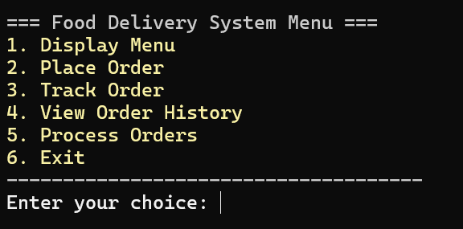
Features
Interactive menu display with categories.
Secure card payment processing and validation.
Dynamic order placement with special instructions.
Track orders and view order history.
Process and complete pending orders.

Slide 7
Workflow
User registers and places order.
Menu displayed using BST (sorted by price).
Order enqueued and prioritized.
Payment processed and stored.
Order processed and status updated.

Slide 8

Time & Space Complexity
Quick Sort: O(n log n) average, O(n^2) worst.
BST Search: O(log n) average, O(n) worst.
Queue Operations: O(1).
Hash Lookup: O(1) average.

Slide 9
Code Structure
main.cpp – Entry point and logic flow.
Restaurant class – Core functionality.
MenuItem, Order, Payment – Core entities.
Custom OrderQueue and BST classes.

Slide 10
Challenges & Solutions
Complex data linking – Solved using maps and pointers.
User input validation – Regex and condition checks.
Order serialization – Custom format for file saving.
Memory management – Manual cleanup in destructors.

Slide 11
Conclusion
Project successfully demonstrates DSA implementation.
Covers custom structures and real-life use cases.
Ready for expansion with GUI or database integration.

Slide 12

Q & A
Thank you! Any questions?

